Slide 1
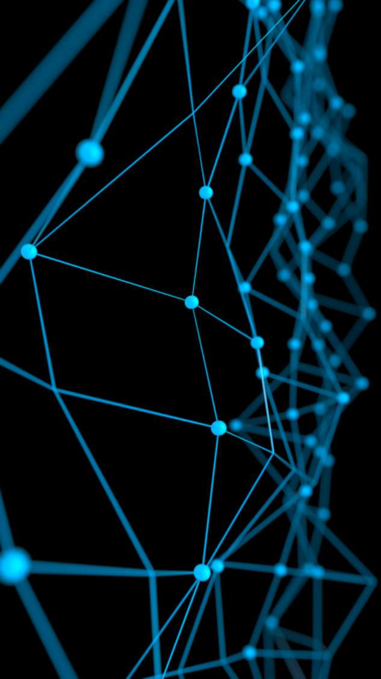
Deep Learning for Natural Language Processing:
Machine Translation
June 2019

Slide 2
Overview
Today we will:
Introduce a new task: Machine Translation
is a major use-case of
Introduce a new neural architecture: sequence-to-sequence
is improved by
Introduce a new neural technique: attention

Slide 3
Pre-Neural Machine Translation

Slide 4
Machine Translation
Machine Translation (MT) is the task of translating a sentence x from one language (the source language) to a sentence y in another language (the target language).
x:
L'homme est né libre, et partout il est dans les fers
y:
Man is born free, but everywhere he is in chains
- Rousseau

Slide 5
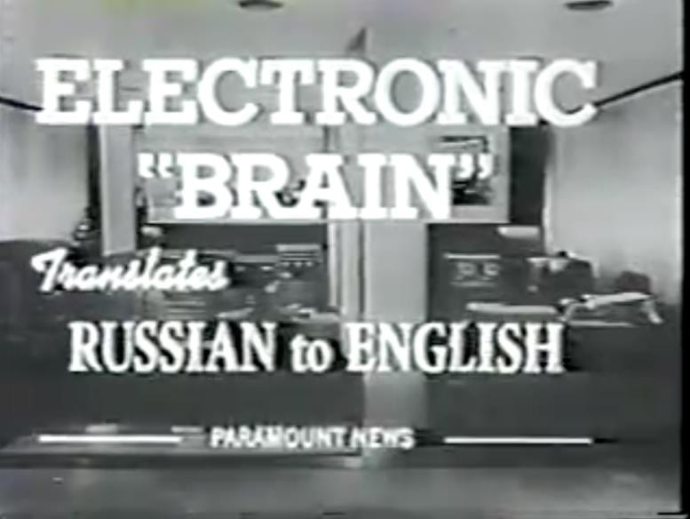
1950s: Early Machine Translation
Machine Translation research began in the early 1950s.
Russian → English
(motivated by the Cold War!)
1 minute video showing 1954 MT:
https://youtu.be/K-HfpsHPmvw
Systems were mostly rule-based, using a bilingual dictionary to map Russian words to their English counterparts

Slide 6


1990s-2010s: Statistical Machine Translation
Core idea: Learn a probabilistic model from data
Suppose we’re translating French → English.
We want to find best English sentence y, given French sentence x
Use Bayes Rule to break this down into two components to be learnt separately:
Translation Model
Models how words and phrases should be translated (fidelity).
Learnt from parallel data.
Language Model
Models how to write good English (fluency).
Learnt from monolingual data.

Slide 7

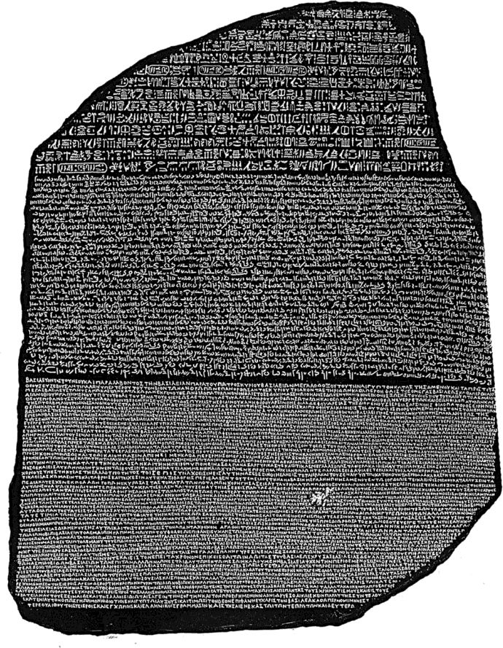
1990s-2010s: Statistical Machine Translation
Question: How to learn translation model ?
First, need large amount of parallel data
(e.g. pairs of human-translated French/English sentences)
The Rosetta Stone
Ancient Egyptian
Demotic
Ancient Greek

Slide 8

Learning alignment for SMT
Question: How to learn translation model parallel corpus?
from the
Break it down further: we actually want to consider
where a is the alignment, i.e. word-level correspondence between French sentence x and English sentence y

Slide 9
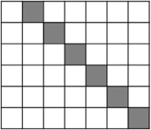
What is alignment?
Alignment is the correspondence between particular words in the translated sentence pair.
Note: Some words have no counterpart
Le
Japon
secoué par deux
nouveaux séismes
spurious word
Le Japon secoué par deux
nouveaux
séismes
Japan shaken
by two
new quakes
Japan shaken
by two new quakes
Examples from: “The Mathematics of Statistical Machine Translation: Parameter Estimation", Brown et al, 1993. http://www.aclweb.org/anthology/J93-2003

Slide 10
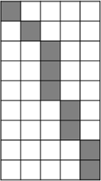
Alignment is complex
Alignment can be many-to-one
Le
reste
appartenait aux autochtones
The balance
was the territory
of the aboriginal
people
Le reste
appartenait
The balance
was the territory
of the aboriginal
people
aux
autochtones
many-to-one alignments
Examples from: “The Mathematics of Statistical Machine Translation: Parameter Estimation", Brown et al, 1993. http://www.aclweb.org/anthology/J93-2003

Slide 11
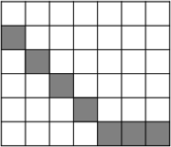
Alignment is complex
Alignment can be one-to-many
not translated
Le
programme a
été
mis en
application
We call this a
fertile word
And the program
has been
Le programme a
été mis en
application
And the program
has
been implemented
implemented
one-to-many alignment
Examples from: “The Mathematics of Statistical Machine Translation: Parameter Estimation", Brown et al, 1993. http://www.aclweb.org/anthology/J93-2003

Slide 12

Alignment is complex
Some words are very fertile!
 | he | hit | me | with | a | pie
il
a
m’
entarté
il a m’
he hit me with a pie
entarté
This word has no single- word equivalent in English

Slide 13
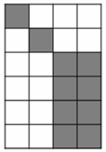
Alignment is complex
Alignment can be many-to-many (phrase-level)
Les
pauvres
sont démunis
The poor don’t have any money
Les pauvres sont démunis
The poor don t have any money
many-to-many alignment
phrase alignment
Examples from: “The Mathematics of Statistical Machine Translation: Parameter Estimation", Brown et al, 1993. http://www.aclweb.org/anthology/J93-2003

Slide 14
Learning alignment for SMT
We learn as a combination of many factors, including:
Probability of particular words aligning (also depends on position in sent)
Probability of particular words having particular fertility (number of corresponding words)
etc.

Slide 15

Decoding for SMT
Language Model
Question:
How to compute this argmax?
Translation Model
We could enumerate every possible y and calculate the
probability? → Too expensive!
Answer: Use a heuristic search algorithm to search for the best translation, discarding hypotheses that are too low-probability
This process is called decoding

Slide 16


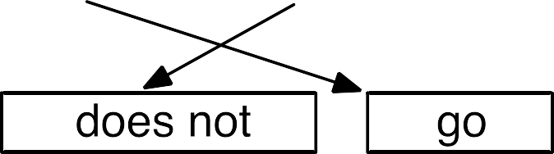

Decoding for SMT
Source: ”Statistical Machine Translation", Chapter 6, Koehn, 2009.
https://www.cambridge.org/core/books/statistical-machine-translation/94EADF9F680558E13BE759997553CDE5

Slide 17

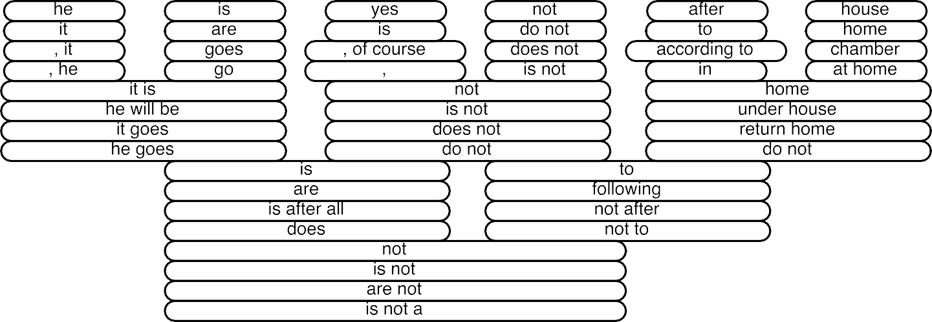

Decoding for SMT
Source: ”Statistical Machine Translation", Chapter 6, Koehn, 2009.
https://www.cambridge.org/core/books/statistical-machine-translation/94EADF9F680558E13BE759997553CDE5

Slide 18
1990s-2010s: Statistical Machine Translation
SMT was a huge research field
The best systems were extremely complex
Hundreds of important details we haven’t mentioned here
Systems had many separately-designed subcomponents
Lots of feature engineering
Need to design features to capture particular language phenomena
Require compiling and maintaining extra resources
Like tables of equivalent phrases
Lots of human effort to maintain
Repeated effort for each language pair!

Slide 19
Neural Machine Translation

Slide 20
2014
(dramatic reenactment)

Slide 21
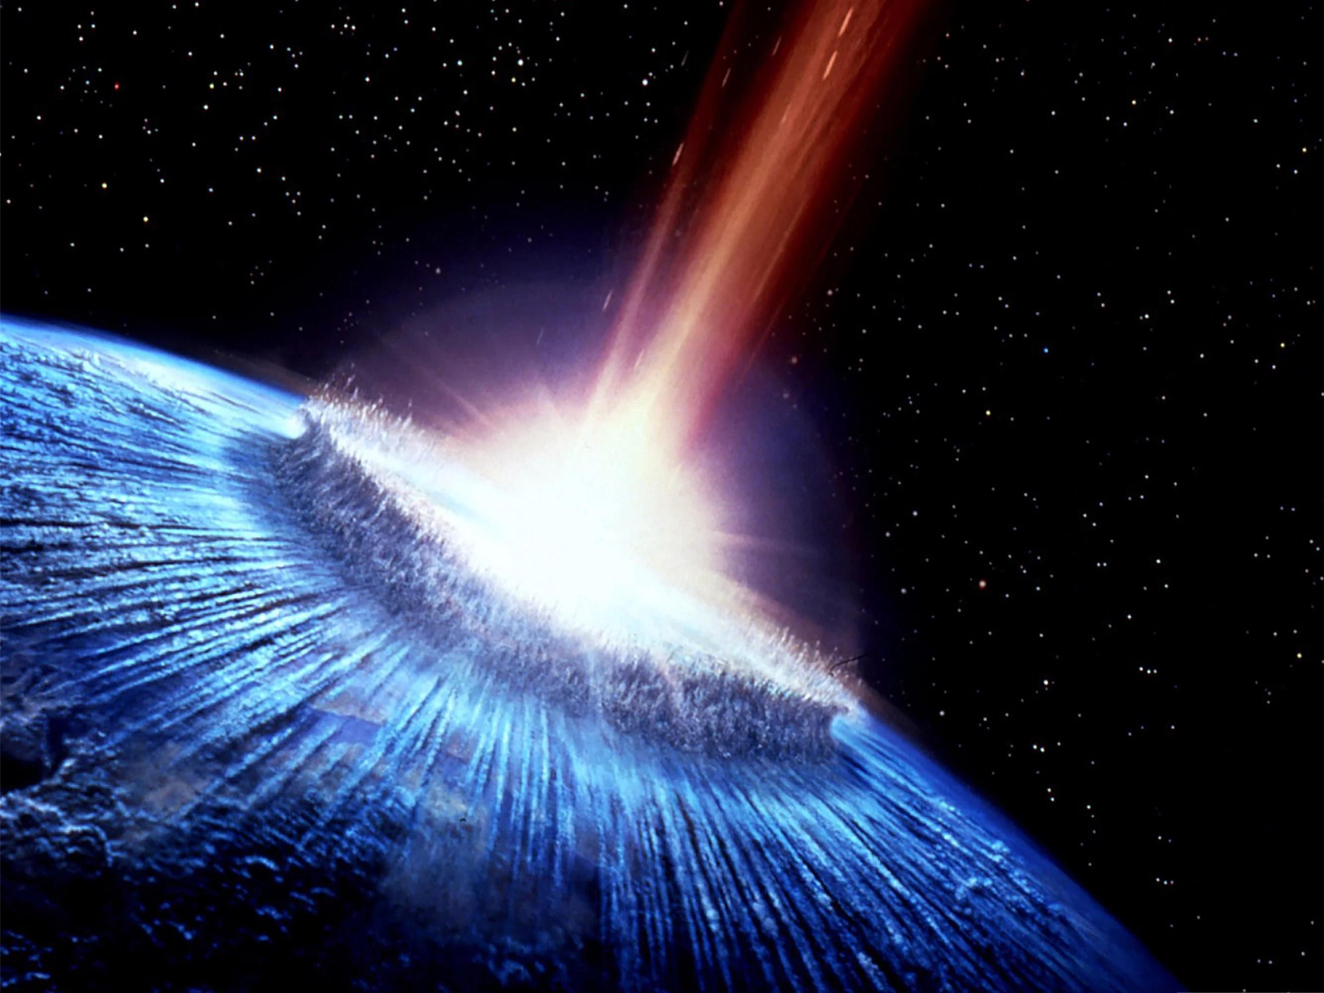
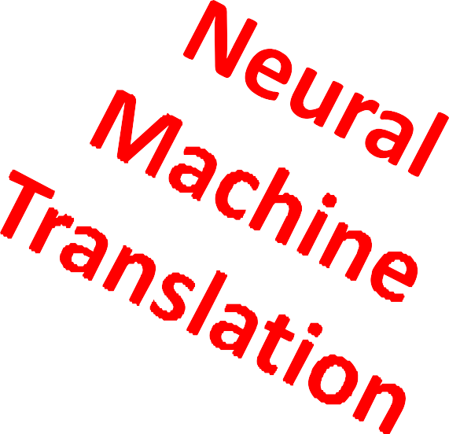

2014
(dramatic reenactment)
22

Slide 22
What is Neural Machine Translation?
Neural Machine Translation (NMT) is a way to do Machine Translation with a single neural network
The neural network architecture is called sequence-to-sequence (aka seq2seq) and it involves two RNNs.

Slide 23
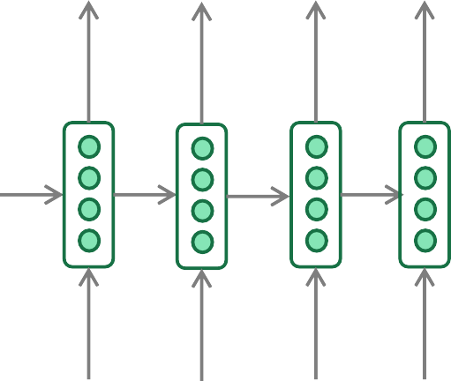
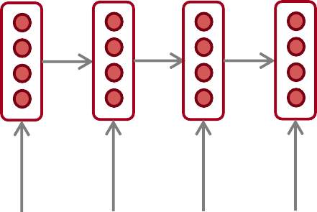
Neural Machine Translation (NMT)
The sequence-to-sequence model
Encoding of the source sentence.
Target sentence (output)
Provides initial hidden state
for Decoder RNN.
he
hit
me
with
a
pie <END>
argmax
argmax
argmax
argmax
argmax
argmax
argmax
Encoder RNN
Decoder RNN
il
a
m’ entarté
<START> he hit me with a pie
Source sentence (input)
Decoder RNN is a Language Model that generates target sentence, conditioned on encoding.
Encoder RNN produces an encoding of the source sentence.
Note: This diagram shows test time behavior:
decoder output is fed in as next step’s input

Slide 24
Sequence-to-sequence is versatile!
Sequence-to-sequence is useful for more than just MT
Many NLP tasks can be phrased as sequence-to-sequence:
Summarization (long text → short text)
Dialogue (previous utterances → next utterance)
Parsing (input text → output parse as sequence)
Code generation (natural language → Python code)

Slide 25

Neural Machine Translation (NMT)
The sequence-to-sequence model is an example of a
Conditional Language Model.
Language Model because the decoder is predicting the next word of the target sentence y
Conditional because its predictions are also conditioned on the source
sentence x
NMT directly calculates :
Probability of next target word, given target words so far and source sentence x
Question: How to train a NMT system?
Answer: Get a big parallel corpus…

Slide 26
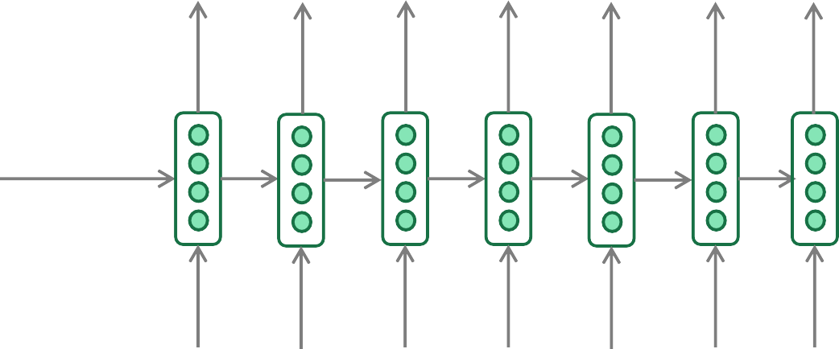
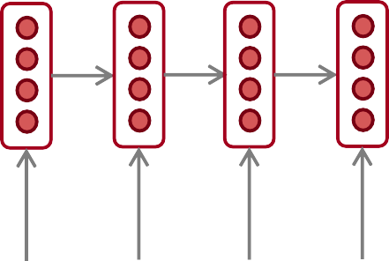
Training a Neural Machine Translation system
= negative log
prob of “he”
= negative log
prob of “with”
= negative log
prob of <END>
1
𝑇
𝐽 = ෍ 𝐽_{𝑡}
𝑇
𝑡=1
=
𝐽₁
+
𝐽₂
+
𝐽₃
+
𝐽₄
+
𝐽₅
+
𝐽₆
+
𝐽₇
𝑦ො₁
𝑦ො₂
𝑦ො₃
𝑦ො₄
𝑦ො₅
𝑦ො₆
𝑦ො₇
Encoder RNN
Decoder RNN
il a m’ entarté
Source sentence (from corpus)
<START> he hit me with
Target sentence (from corpus)
a
pie
Seq2seq is optimized as a single system.
Backpropagation operates “end-to-end”.

Slide 27
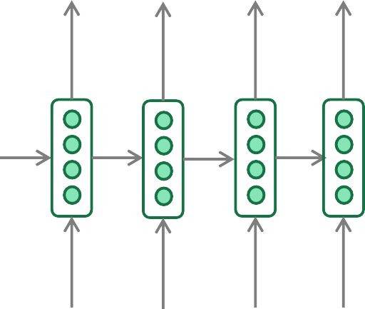
Greedy decoding
We saw how to generate (or “decode”) the target sentence by
taking argmax on each step of the decoder
he hit me with a pie <END>
argmax
argmax
argmax
argmax
argmax
argmax
argmax
<START> he hit me with a pie
This is greedy decoding (take most probable word on each step)
Problems with this method?

Slide 28
Problems with greedy decoding
Greedy decoding has no way to undo decisions!
Input: il a m’entarté
→ he
→ he hit
→ he hit a
(he hit me with a pie)
(whoops! no going back now…)
How to fix this?

Slide 29
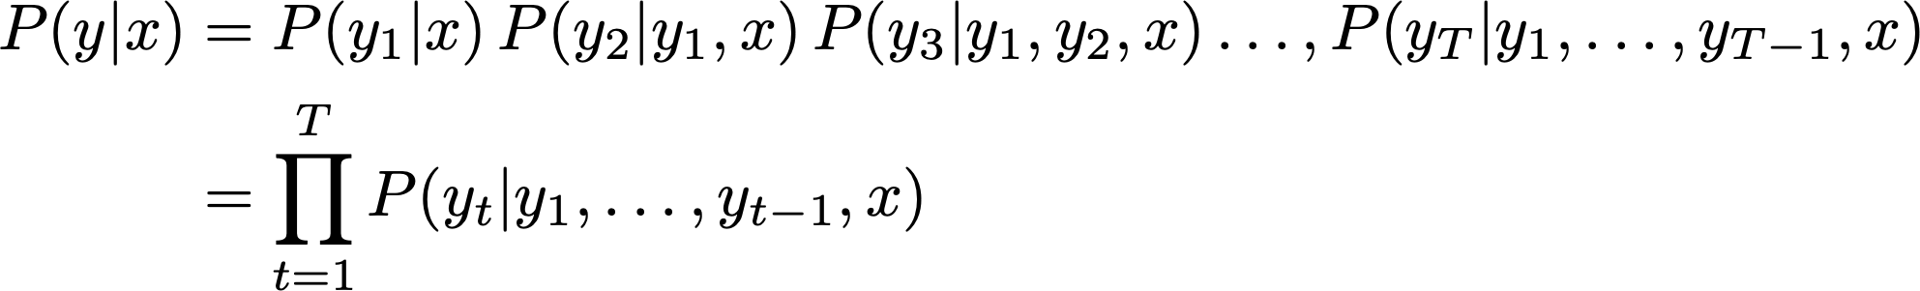
Exhaustive search decoding
Ideally we want to find a (length T) translation y that maximizes
We could try computing all possible sequences y
This means that on each step t of the decoder, we’re tracking V^{t} possible partial translations, where V is vocab size
This O(V^{T}) complexity is far too expensive!

Slide 30

Beam search decoding
Core idea: On each step of decoder, keep track of the k most probable partial translations (which we call hypotheses)
k is the beam size (in practice around 5 to 10)
A hypothesis has a score which is its log probability:
Scores are all negative, and higher score is better
We search for high-scoring hypotheses, tracking top k on each step
Beam search is not guaranteed to find optimal solution
But much more efficient than exhaustive search!

Slide 31
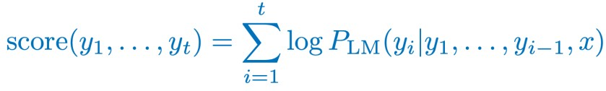
Beam search decoding: example
Beam size = k = 2. Blue numbers =
<START>
Calculate prob
dist of next word

Slide 32
Beam search decoding: example
Beam size = k = 2. Blue numbers =
-0.7 = log P_{LM}(he|<START>)
he
<START>
I
-0.9 = log P_{LM}(I|<START>)
Take top k words and compute scores

Slide 33
Beam search decoding: example
Beam size = k = 2. Blue numbers =
-1.7 = log P_{LM}(hit|<START> he) + -0.7
-0.7
hit
he
struck
-2.9 = log P_{LM}(struck|<START> he) + -0.7
<START>
-1.6 = log P_{LM}(was|<START> I) + -0.9
was
I
got
-0.9
-1.8 = log P_{LM}(got|<START> I) + -0.9
For each of the k hypotheses, find
top k next words and calculate scores

Slide 34
Beam search decoding: example
Beam size = k = 2. Blue numbers =
-1.7
-0.7
hit
he
struck
-2.9
<START>
-1.6
was
I
got
-0.9
-1.8
Of these k² hypotheses,
just keep k with highest scores

Slide 35
Beam search decoding: example
Beam size = k = 2. Blue numbers =
-2.8 = log P_{LM}(a|<START> he hit) + -1.7
-1.7
a
-0.7
hit
he
me
struck
-2.5 = log P_{LM}(me|<START> he hit) + -1.7
-2.9
<START>
-2.9 = log P_{LM}(hit|<START> I was) + -1.6
-1.6
hit
was
I
struck
got
-0.9
-3.8 = log P_{LM}(struck|<START> I was) + -1.6
-1.8
For each of the k hypotheses, find
top k next words and calculate scores

Slide 36
Beam search decoding: example
Beam size = k = 2. Blue numbers =
-2.8
-1.7
a
-0.7
hit
he
me
struck
-2.5
-2.9
<START>
-2.9
-1.6
hit
was
I
struck
got
-0.9
-3.8
-1.8
Of these k² hypotheses,
just keep k with highest scores

Slide 37
Beam search decoding: example
Beam size = k = 2. Blue numbers =
-4.0
tart
-2.8
pie
-1.7
a
-0.7
hit
-3.4
he
me
-3.3
struck
-2.5
with
-2.9
<START>
-2.9
on
-1.6
hit
-3.5
was
I
struck
got
-0.9
-3.8
-1.8
For each of the k hypotheses, find
top k next words and calculate scores

Slide 38
Beam search decoding: example
Beam size = k = 2. Blue numbers =
-4.0
tart
-2.8
pie
-1.7
a
-0.7
hit
-3.4
he
me
-3.3
struck
-2.5
with
-2.9
<START>
-2.9
on
-1.6
hit
-3.5
was
I
struck
got
-0.9
-3.8
-1.8
Of these k² hypotheses,
just keep k with highest scores

Slide 39
Beam search decoding: example
Beam size = k = 2. Blue numbers =
-4.0
-4.8
tart
in
-2.8
pie
with
-1.7
a
-0.7
hit
-3.4
-4.5
he
me
-3.3
-3.7
struck
-2.5
with
a
-2.9
<START>
-2.9
on
one
-1.6
hit
-3.5
-4.3
was
I
struck
got
-0.9
-3.8
-1.8
For each of the k hypotheses, find
top k next words and calculate scores

Slide 40
Beam search decoding: example
Beam size = k = 2. Blue numbers =
-4.0
-4.8
tart
in
-2.8
pie
with
-1.7
a
-0.7
hit
-3.4
-4.5
he
me
-3.3
-3.7
struck
-2.5
with
a
-2.9
<START>
-2.9
on
one
-1.6
hit
-3.5
-4.3
was
I
struck
got
-0.9
-3.8
-1.8
Of these k² hypotheses,
just keep k with highest scores

Slide 41
Beam search decoding: example
Beam size = k = 2. Blue numbers =
-4.0
-4.8
tart
in
-2.8
-4.3
pie
with
-1.7
a
-3.4
pie
-0.7
hit
-4.5
he
me
-3.3
-3.7
tart
struck
-2.5
with
a
-4.6
-2.9
<START>
-2.9
on
one
-5.0
-1.6
hit
pie
-3.5
-4.3
was
I
struck
tart
got
-0.9
-3.8
-5.3
-1.8
For each of the k hypotheses, find
top k next words and calculate scores

Slide 42
Beam search decoding: example
Beam size = k = 2. Blue numbers =
-4.0
-4.8
tart
in
-2.8
-4.3
pie
with
-1.7
a
-3.4
pie
-0.7
hit
-4.5
he
me
-3.3
-3.7
tart
struck
-2.5
with
a
-4.6
-2.9
<START>
-2.9
on
one
-5.0
-1.6
hit
pie
-3.5
-4.3
was
I
struck
tart
got
-0.9
-3.8
-5.3
-1.8
This is the top-scoring hypothesis!

Slide 43
Beam search decoding: example
Beam size = k = 2. Blue numbers =
-4.0
-4.8
tart
in
-2.8
-4.3
pie
with
-1.7
a
-3.4
pie
-0.7
hit
-4.5
he
me
-3.3
-3.7
tart
struck
-2.5
with
a
-4.6
-2.9
<START>
-2.9
on
one
-5.0
-1.6
hit
pie
-3.5
-4.3
was
I
struck
tart
got
-0.9
-3.8
-5.3
-1.8
Backtrack to obtain the full hypothesis

Slide 44
Beam search decoding: stopping criterion
In greedy decoding, usually we decode until the model produces a <END> token
For example: <START> he hit me with a pie <END>
In beam search decoding, different hypotheses may produce
<END> tokens on different timesteps
When a hypothesis produces <END>, that hypothesis is complete.
Place it aside and continue exploring other hypotheses via beam search.
Usually we continue beam search until:
We reach timestep T (where T is some pre-defined cutoff), or
We have at least n completed hypotheses (where n is pre-defined cutoff)

Slide 45
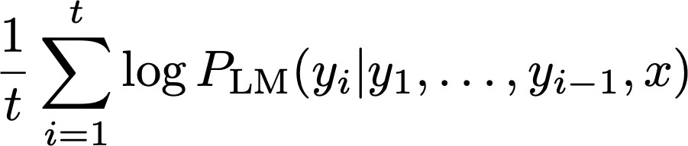
Beam search decoding: finishing up
We have our list of completed hypotheses.
How to select top one with highest score?
Each hypothesis on our list has a score
Problem with this: longer hypotheses have lower scores
Fix: Normalize by length. Use this to select top one instead:

Slide 46
Advantages of NMT
Compared to SMT, NMT has many advantages:
Better performance
More fluent
Better use of context
Better use of phrase similarities
A single neural network to be optimized end-to-end
No subcomponents to be individually optimized
Requires much less human engineering effort
No feature engineering
Same method for all language pairs

Slide 47
Disadvantages of NMT?
Compared to SMT:
NMT is less interpretable
Hard to debug
NMT is difficult to control
For example, can’t easily specify rules or guidelines for
translation
Safety concerns!

Slide 48
How do we evaluate Machine Translation?
BLEU (Bilingual Evaluation Understudy)
You’ll see BLEU in detail
in Assignment 4!
BLEU compares the machine-written translation to one or several human-written translation(s), and computes a similarity score based on:
n-gram precision (usually for 1, 2, 3 and 4-grams)
Plus a penalty for too-short system translations
BLEU is useful but imperfect
There are many valid ways to translate a sentence
So a good translation can get a poor BLEU score because it has low n-gram overlap with the human translation ☹
Source: ” BLEU: a Method for Automatic Evaluation of Machine Translation", Papineni et al, 2002.

Slide 49
MT progress over time
[Edinburgh En-De WMT newstest2013 Cased BLEU; NMT 2015 from U. Montréal]
Phrase-based SMT Syntax-based SMT Neural MT
25
20
15
10
5
0
2013
2014
2015
2016
Source: http://www.meta-net.eu/events/meta-forum-2016/slides/09_sennrich.pdf

Slide 50
NMT: the biggest success story of NLP Deep Learning
Neural Machine Translation went from a fringe research activity in
2014 to the leading standard method in 2016
2014: First seq2seq paper published
2016: Google Translate switches from SMT to NMT
This is amazing!
SMT systems, built by hundreds of engineers over many years, outperformed by NMT systems trained by a handful of engineers in a few months

Slide 51
So is Machine Translation solved?
Nope!
Many difficulties remain:
Out-of-vocabulary words
Domain mismatch between train and test data
Maintaining context over longer text
Low-resource language pairs
Further reading: “Has AI surpassed humans at translation? Not even close!”
https://www.skynettoday.com/editorials/state_of_nmt

Slide 52
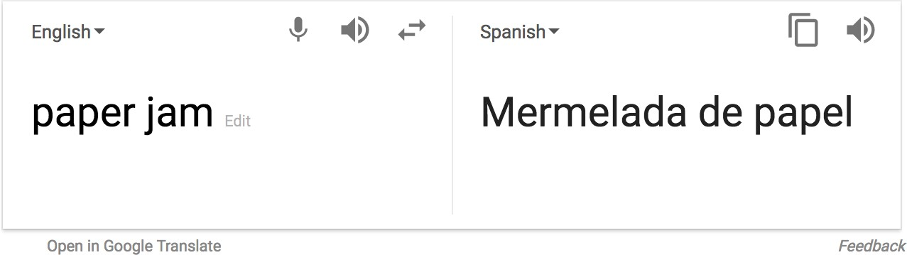

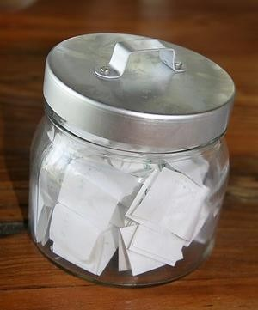
So is Machine Translation solved?
Nope!
Using common sense is still hard
?

Slide 53
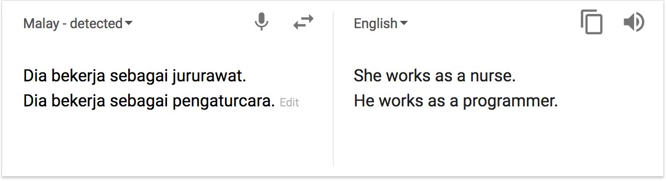
So is Machine Translation solved?
Nope!
NMT picks up biases in training data
Didn’t specify gender
Source: https://hackernoon.com/bias-sexist-or-this-is-the-way-it-should-be-ce1f7c8c683c

Slide 54
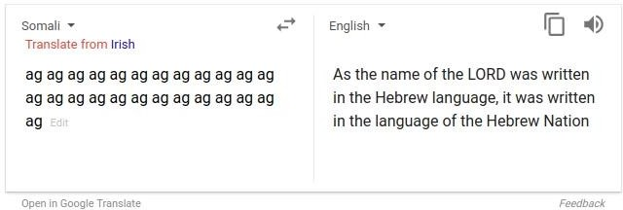
So is Machine Translation solved?
Nope!
Uninterpretable systems do strange things
Picture source: https://www.vice.com/en_uk/article/j5npeg/why-is-google-translate-spitting-out-sinister-religious-prophecies
Explanation: https://www.skynettoday.com/briefs/google-nmt-prophecies

Slide 55
NMT research continues
NMT is the flagship task for NLP Deep Learning
NMT research has pioneered many of the recent innovations of NLP Deep Learning
In 2019: NMT research continues to thrive
Researchers have found many, many improvements to the
“vanilla” seq2seq NMT system we’ve presented today
But one improvement is so integral that it is the new vanilla…
ATTENTION

Slide 56
Attention

Slide 57
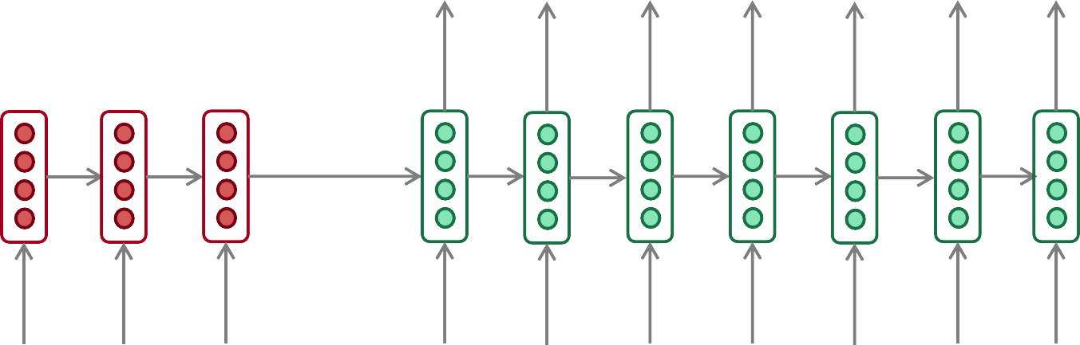
Sequence-to-sequence: the bottleneck problem
Encoding of the
source sentence.
Target sentence (output)
he
hit
me with
a
pie <END>
Encoder RNN
Decoder RNN
il
a
m’ entarté
<START> he
hit
me with
a
pie
Source sentence (input)
Problems with this architecture?

Slide 58
Sequence-to-sequence: the bottleneck problem
Encoding of the
source sentence.
This needs to capture all information about the source sentence.
Information bottleneck!
Target sentence (output)
he
hit
me with
a
pie <END>
Encoder RNN
Decoder RNN
il
a
m’ entarté
<START> he
hit
me with
a
pie
Source sentence (input)

Slide 59

Attention
Attention provides a solution to the bottleneck problem.
Core idea: on each step of the decoder, use direct connection to the encoder to focus on a particular part of the source sequence
First we will show via diagram (no equations), then we will show with equations

Slide 60
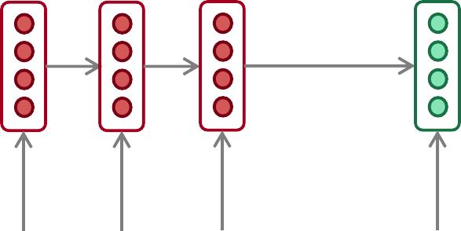
Sequence-to-sequence with attention
dot product
Attention
scores
Decoder RNN
Encoder
RNN
il
a
m’ entarté
<START>
Source sentence (input)

Slide 61
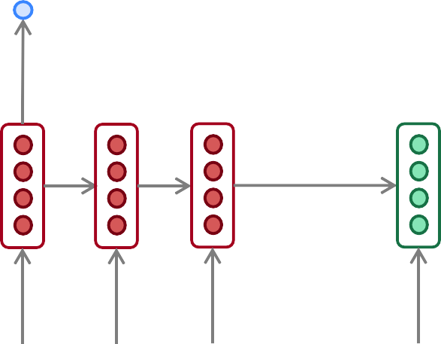
Sequence-to-sequence with attention
dot product
Attention
scores
Decoder RNN
Encoder
RNN
il
a
m’ entarté
<START>
Source sentence (input)

Slide 62
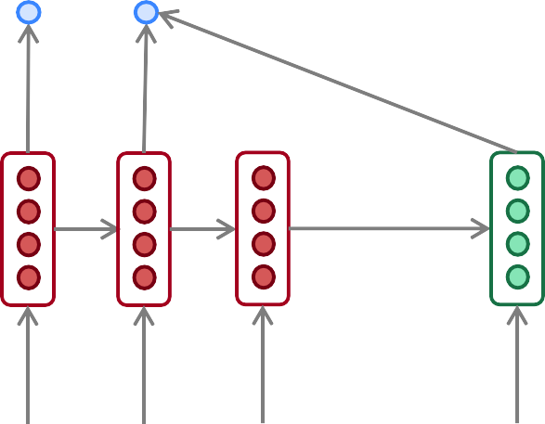
Sequence-to-sequence with attention
dot product
Attention
scores
Decoder RNN
Encoder
RNN
il
a
m’ entarté
<START>
Source sentence (input)

Slide 63
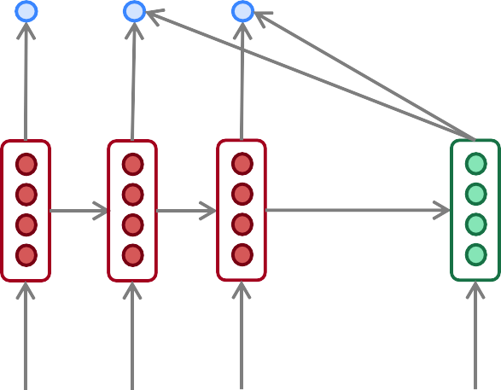
Sequence-to-sequence with attention
dot product
Attention
scores
Decoder RNN
Encoder
RNN
il
a
m’ entarté
<START>
Source sentence (input)

Slide 64
Sequence-to-sequence with attention
On this decoder timestep, we’re mostly focusing on the first encoder hidden state (”he”)
Attention
distribution
Take softmax to turn the scores into a probability distribution
Attention
scores
Decoder RNN
Encoder
RNN
il
a
m’ entarté
<START>
Source sentence (input)

Slide 65
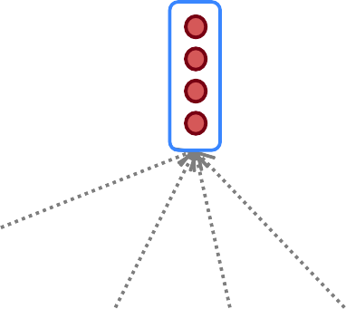
Sequence-to-sequence with attention
Attention output
Use the attention distribution to take a weighted sum of the encoder hidden states.
The attention output mostly contains information from the hidden states that received high attention.
Attention
distribution
Attention
scores
Decoder RNN
Encoder
RNN
il
a
m’ entarté
<START>
Source sentence (input)

Slide 66
Sequence-to-sequence with attention
Attention output
he
Concatenate attention output with decoder hidden state, then use to compute 𝑦ො₁ as before
Attention
distribution
𝑦ො₁
Attention
scores
Decoder RNN
Encoder
RNN
il
a
m’ entarté
<START>
Source sentence (input)

Slide 67
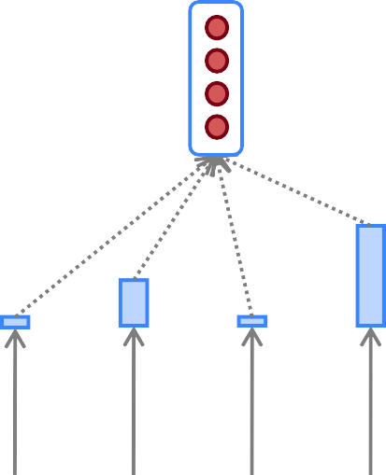
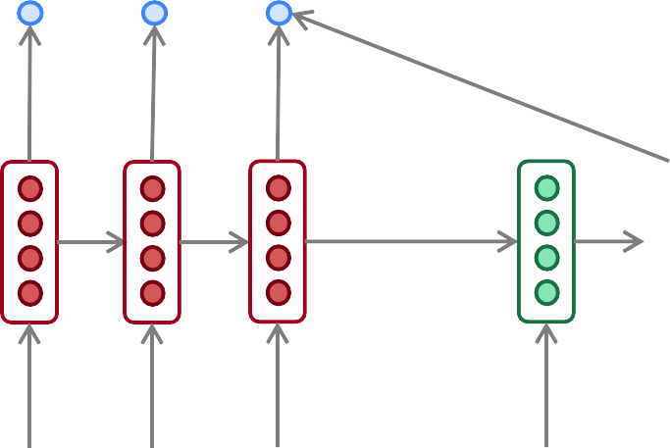
Sequence-to-sequence with attention
Attention output
hit
Attention
distribution
𝑦ො₂
Attention
scores
Decoder RNN
Encoder
RNN
Sometimes we take the attention output from the previous step, and also feed it into the decoder (along with the usual decoder input). We do this in Assignment 4.
il
a
m’ entarté
<START> he
Source sentence (input)

Slide 68
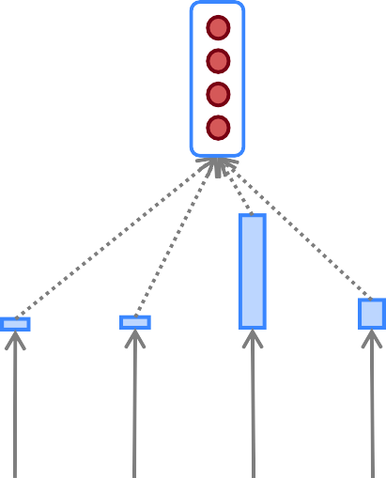
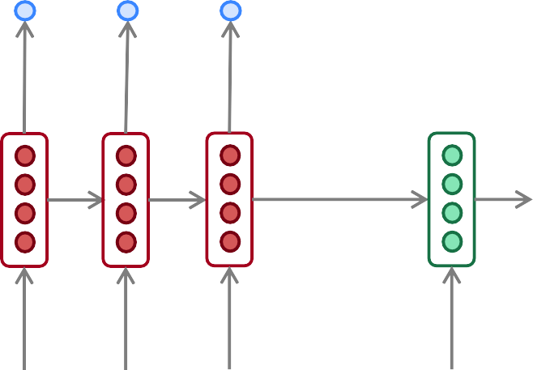
Sequence-to-sequence with attention
Attention output
me
Attention
distribution
𝑦ො₃
Attention
scores
Decoder RNN
Encoder
RNN
il
a
m’ entarté
<START> he
hit
Source sentence (input)

Slide 69
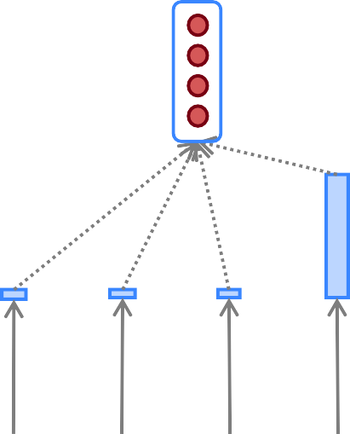
Sequence-to-sequence with attention
Attention output
with
Attention
distribution
𝑦ො₄
Attention
scores
Decoder RNN
Encoder
RNN
il
a
m’ entarté
<START> he
hit
me
Source sentence (input)

Slide 70
Sequence-to-sequence with attention
Attention output
a
Attention
distribution
𝑦ො₅
Attention
scores
Decoder RNN
Encoder
RNN
il
a
m’ entarté
<START> he
hit
me with
Source sentence (input)

Slide 71
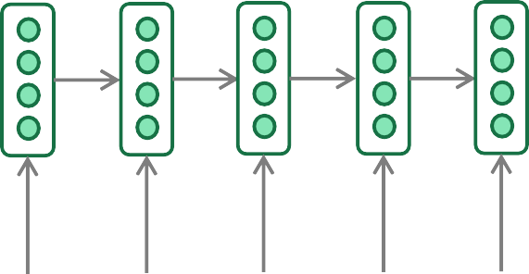
Sequence-to-sequence with attention
Attention output
pie
Attention
distribution
𝑦ො₆
Attention
scores
Decoder RNN
Encoder
RNN
il
a
m’ entarté
<START> he
hit
me with
a
Source sentence (input)

Slide 72
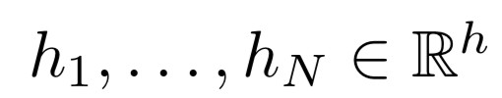






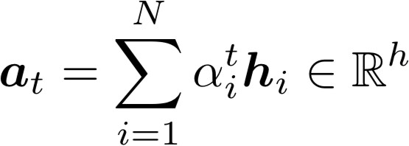



Attention: in equations
We have encoder hidden states
On timestep t, we have decoder hidden state
We get the attention scores for this step:
We take softmax to get the attention distribution
probability distribution and sums to 1)
for this step (this is a
We use to take a weighted sum of the encoder hidden states to get the
attention output
Finally we concatenate the attention output with the decoder hidden state and proceed as in the non-attention seq2seq model

Slide 73
Attention is great
Attention significantly improves NMT performance
It’s very useful to allow decoder to focus on certain parts of the source
Attention solves the bottleneck problem
Attention allows decoder to look directly at source; bypass bottleneck
Attention helps with vanishing gradient problem
Provides shortcut to faraway states
Attention provides some interpretability
By inspecting attention distribution, we can see what the decoder was focusing on
We get (soft) alignment for free!
This is cool because we never explicitly trained an alignment system
The network just learned alignment by itself
he | hit | me | with | a | pie
il
a
m’
entarté

Slide 74
Attention is a general Deep Learning technique
We’ve seen that attention is a great way to improve the
sequence-to-sequence model for Machine Translation.
However: You can use attention in many architectures (not just seq2seq) and many tasks (not just MT)
More general definition of attention:
Given a set of vector values, and a vector query, attention is a technique to compute a weighted sum of the values, dependent on the query.
We sometimes say that the query attends to the values.
For example, in the seq2seq + attention model, each decoder hidden state (query) attends to all the encoder hidden states (values).

Slide 75
Attention is a general Deep Learning technique
More general definition of attention:
Given a set of vector values, and a vector query, attention is a technique to compute a weighted sum of the values, dependent on the query.
Intuition:
The weighted sum is a selective summary of the information contained in the values, where the query determines which values to focus on.
Attention is a way to obtain a fixed-size representation of an arbitrary set of representations (the values), dependent on some other representation (the query).

Slide 76




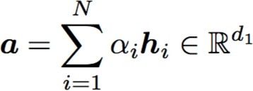
There are several attention variants
We have some values and a query
Attention always involves:
There are multiple ways to do this
Computing the attention scores
Taking softmax to get attention distribution ⍺:
3. Using attention distribution to take weighted sum of values:
thus obtaining the attention output a (sometimes called the
context vector)

Slide 77






Attention variants
You’ll think about the relative
advantages/disadvantages of these in Assignment 4!
There are several ways you can compute from
and :
Basic dot-product attention:
Note: this assumes
This is the version we saw earlier
Multiplicative attention:
Where is a weight matrix
Additive attention:
Where
is a weight vector.
are weight matrices and
d₃ (the attention dimensionality) is a hyperparameter
More information: “Deep Learning for NLP Best Practices”, Ruder, 2017. http://ruder.io/deep-learning-nlp-best-practices/index.html#attention “Massive Exploration of Neural Machine Translation Architectures”, Britz et al, 2017, https://arxiv.org/pdf/1703.03906.pdf

Slide 78
Summary of today’s lecture
We learned some history of Machine Translation (MT)
Since 2014, Neural MT rapidly replaced intricate Statistical MT
Sequence-to-sequence is the architecture for NMT (uses 2 RNNs)
Attention is a way to focus on particular parts of the input
Improves sequence-to-sequence a lot!

